Slide 1
Chapter 8
Understanding Requirements
Software Engineering: A Practitioner’s Approach, 8th edition
by Roger S. Pressman

Slide 2
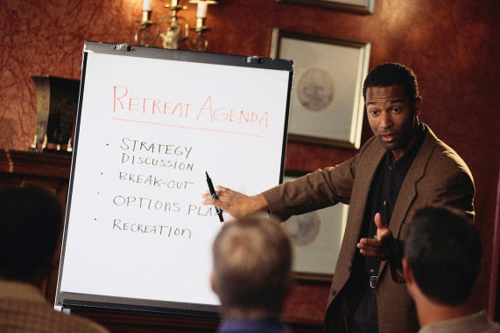
Outline
What is RE?
RE Tasks
RE Process
Eliciting Requirements（需求获取）
Developing Use-Case（用例）
Building the Analysis Model
Negotiating Requirements
Validating Requirements

Slide 3
Outline
What is RE?
RE Tasks
RE Process
Eliciting Requirements（需求获取）
Developing Use-Case（用例）
Building the Analysis Model
Negotiating Requirements
Validating Requirements

Slide 4
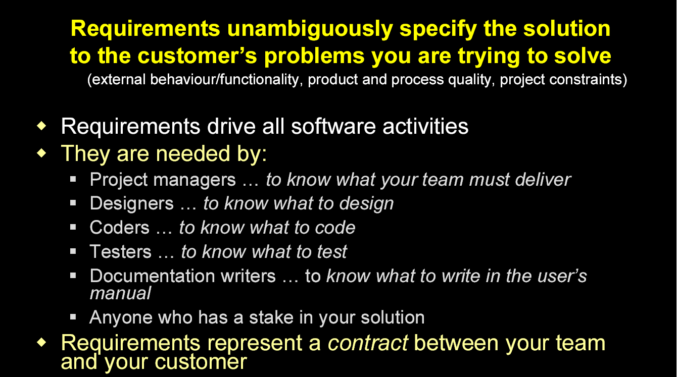
What are Requirements?

Slide 5
Importance of Requirements
The set of requirements constitute a contract between the client and the software developer
  It should be written such that all stakeholders can understand what the system will do.
  It allows developer to map problem domain concepts to solution domain concepts

Slide 6
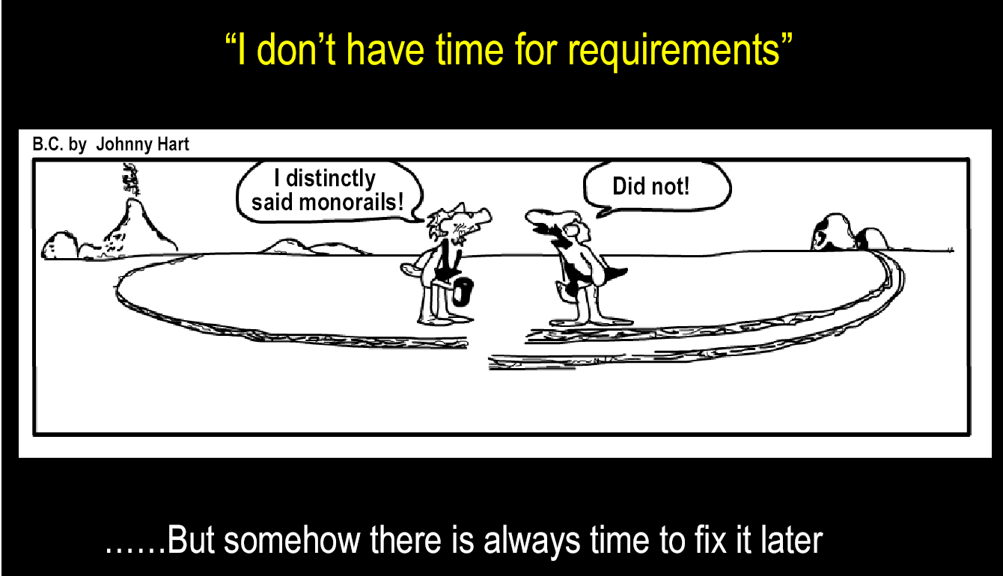
Importance of Requirements

Slide 7
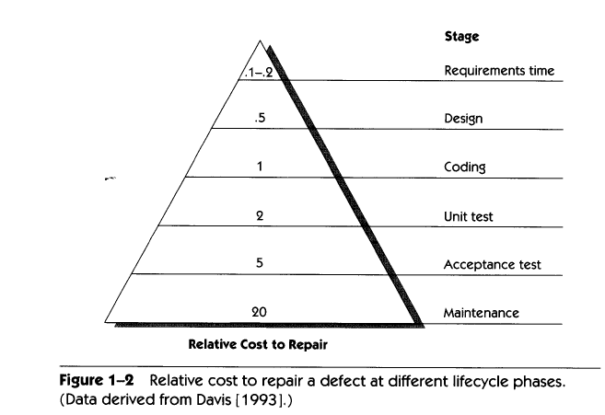
High Cost of Requirements Errors

Slide 8

Requirements Engineering
It helps software engineering to better understand the problem to be solved;
It encompasses the set of questions:
  What is the business impact of the software?
  What the customer wants?
  How end-users will interact with the software?

Slide 9

A Bridge to Design and Construction
Requirements engineering establishes a solid base for design and construction.
Without it, the resulting software has a high probability of not meeting customers’ needs.

Slide 10
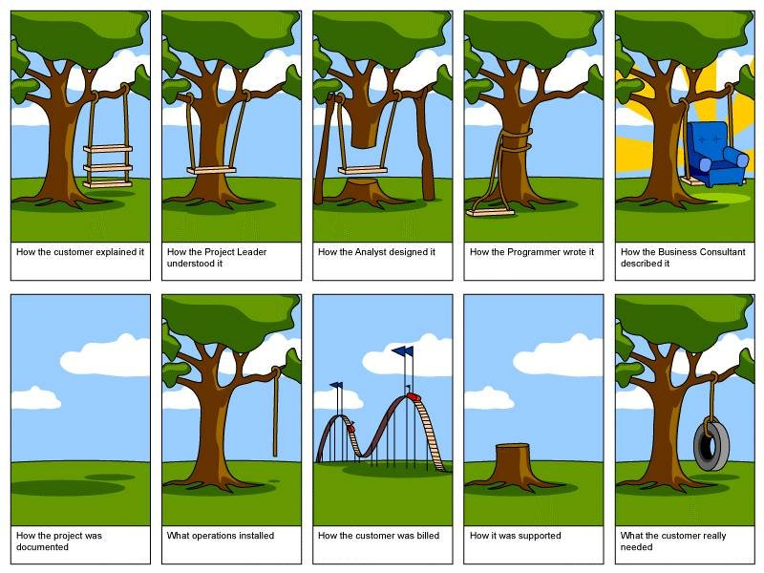

Slide 11
Outline
What is RE?
RE Tasks
RE Process
Eliciting Requirements（需求获取）
Developing Use-Case（用例）
Building the Analysis Model
Negotiating Requirements
Validating Requirements

Slide 12
Requirements Engineering Tasks
Inception（初启）—Establish a basic understanding of the problem and the nature of the solution.
Elicitation（导出）—Draw out the requirements from stakeholders.
Elaboration（精化）—Create an analysis model that represents information, functional, and behavioral aspects of the requirements.
Negotiation（谈判）—Agree on a deliverable system that is realistic for developers and customers.
Specification（规格说明）—Describe the requirements formally or informally.
Validation（确认）—Review the requirement specification for errors, ambiguities（模糊）, omissions（遗漏）, and conflicts.
Requirements management（管理）—Manage changing requirements.

Slide 13

Inception（初启）
Ask “context-free” questions
  Who is behind the request for this work?
  Who will use the solution (product/system)?
  What will be the economic benefits?
  How would you characterize “good” output from the system?
  What problems does this solution address?
  What environment will the product be used in?
  Are you the right person to answer these questions?
  Are these question relevant?
  Can anyone else provide additional information?
  Should I be asking you anything else?

Slide 14

Elicitation（导出）
Why is it so difficult to clearly understand what the customer wants?
  Scope
    The boundary of the system is ill-defined.
    Customers/users specify unnecessary technical detail that may confuse rather than clarify objectives.
  Understanding
    Customers are not completely sure of what is needed.
    Customers have a poor understanding of the capabilities and limitations of the computing environment.
    Customers don’t have a full understanding of their problem domain.
    Customers have trouble communicating needs to the system engineer.
    Customers omit detail that is believed to be obvious.
    Customers specify requirements that are ambiguous or untestable.
  Volatility
    Requirements change over time.

Slide 15

Elaboration（求精）
It is a good thing, but you have to know when to stop;
The key is to describe the problem in a way that establishes a firm base for design;
If you work beyond that point, you’re doing design;

Slide 16

Negotiation（谈判）
There should be no winner and no loser in an effective negotiation（ Win – Win );
Both sides win because a “deal” that both can live with is solidified.

Slide 17

Specification（规格说明）
The formality and format of a specification varies with the size and the complexity of the software to be built.

Slide 18

Validation（确认）
A key concern during requirements validation is consistency（一致性）;
Use the analysis model to ensure that requirements have been consistently stated;

Slide 19
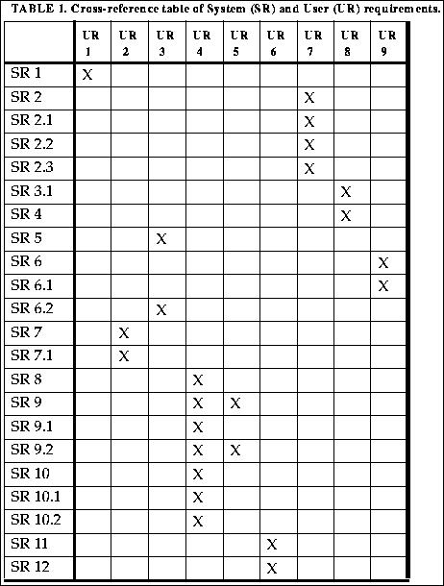
Requirements Management
Features traceability table;
Source traceability table;
Dependency traceability table;
Subsystem traceability table;
Interface traceability table;

Slide 20
How to maintain traceability relationships …
Most easily maintained using tools.
Low tech tools: e.g. Excel, Word, …
  Can be good enough (and better than nothing).
Specialized tools: e.g. RequisitePro.
  Tools can be used to automatically generate views in the form to Matrices.
  NOTE: consider the cost of learning and using tools.

Slide 21
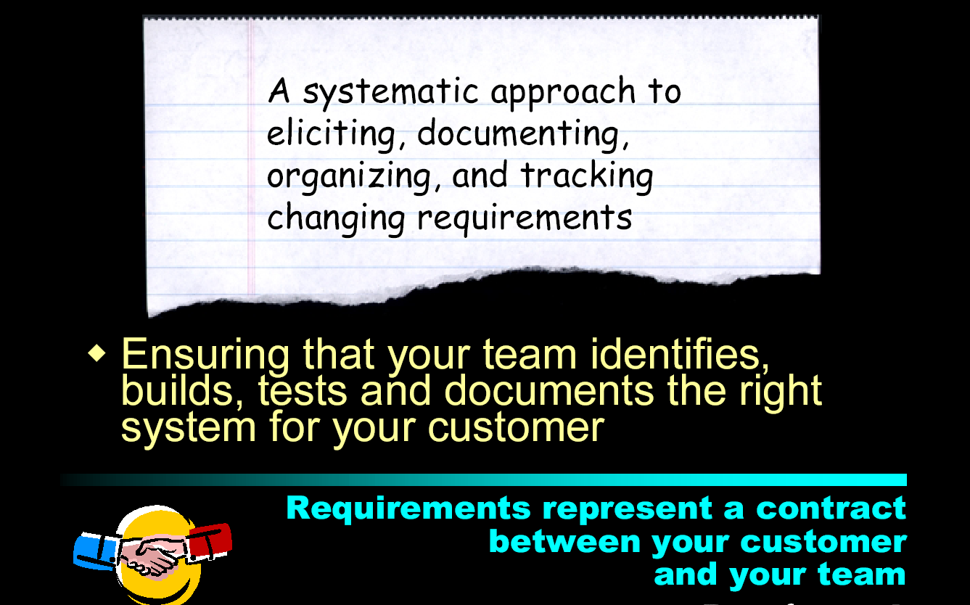
What is Requirements Management?

Slide 22
Outline
What is RE?
RE Tasks
RE Process
Eliciting Requirements（需求获取）
Developing Use-Case（用例）
Building the Analysis Model
Negotiating Requirements
Validating Requirements

Slide 23
Getting Requirements Right
“The hardest single part of building a software system is deciding what to build. No part of the work so cripples the resulting system if done wrong. No other part is more difficult to rectify later.”
—Fred Brooks
“The seeds of major software disasters are usually sown within the first three months of commencing the software project.”
—Capers Jones
“We spend a lot of time—the majority of project effort—not implementing or testing, but trying to decide what to build.”
—Brian Lawrence

Slide 24

RE Process
Identifying the stakeholders
Recognizing multiple viewpoints
Working toward collaboration
Asking the first questions

Slide 25

Stakeholders in SE
Customers
  Those who pay for the software
Users
  Those who use the software
Software developers
Development Managers
Problem: The customer often doesn’t have good grasp of what he wants.

Slide 26
Outline
What is RE?
RE Tasks
RE Process
Eliciting Requirements（需求获取）
Developing Use-Case（用例）
Building the Analysis Model
Negotiating Requirements
Validating Requirements

Slide 27

Eliciting Requirements
Collaborative Requirements Gathering;
Quality Function Deployment;
User Scenarios;
Elicitation Work Products;

Slide 28

Collaborative Requirements Gathering
How to conduct a meeting?
Meetings are attended by all interested stakeholders.
Rules established for preparation and participation.
Agenda should be formal enough to cover all important points, but informal enough to encourage the free flow of ideas.
A facilitator controls the meeting.
A definition mechanism (blackboard, flip charts, etc.) is used.

Slide 29

Collaborative Requirements Gathering
During the meeting:
  The problem is identified.
  Elements of the solution are proposed.
  Different approaches are negotiated.
  A preliminary set of solution requirements are obtained.
  The atmosphere is collaborative and non-threatening.

Slide 30

Quality Function Deployment
QFD Defines requirements in a way that maximizes customer satisfaction.
Three types of requirements:
  Normal Requirements;
  Expected Requirements;
  Exciting Requirements;

Slide 31

Three Level Requirements
Stakeholder Needs
Features of the System
Software Requirements

Slide 32
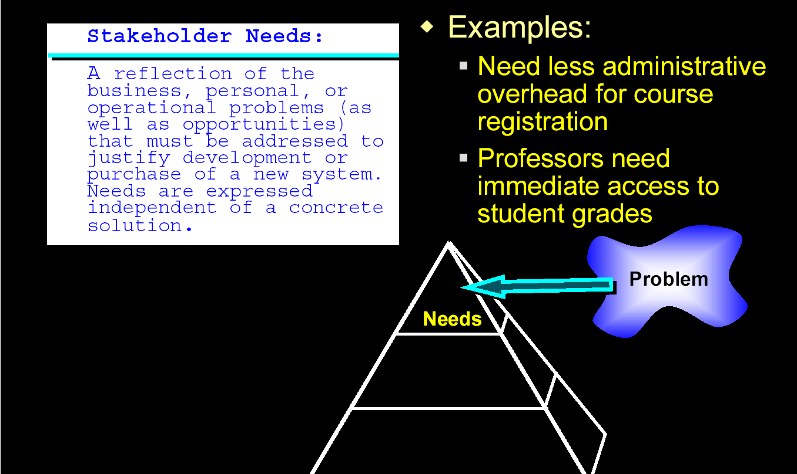
Stakeholder Needs
(extracted from the slides of Peter Hauker, Rational)

Slide 33
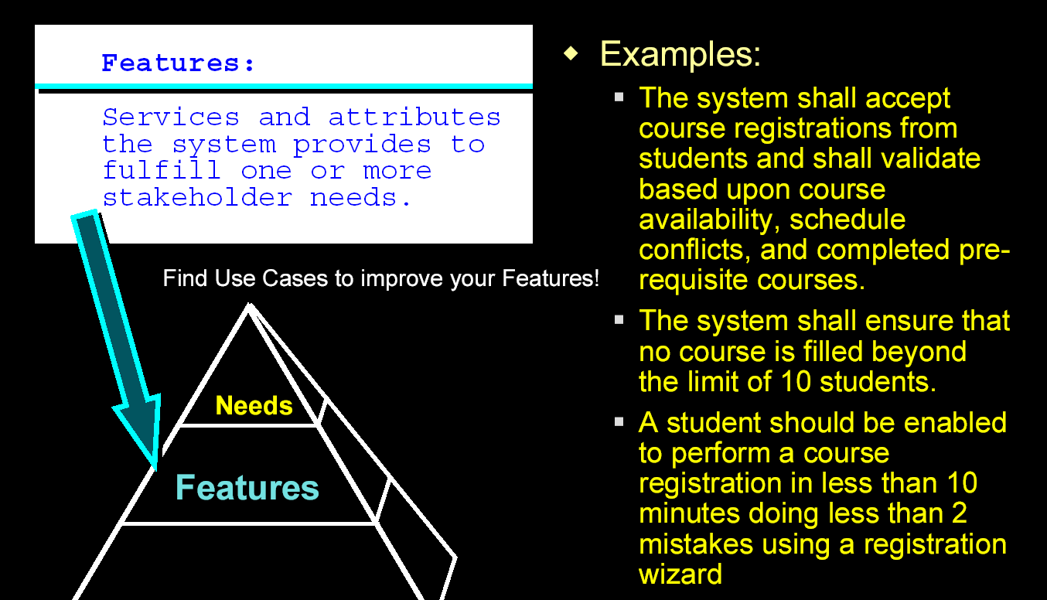
Features of the System

Slide 34
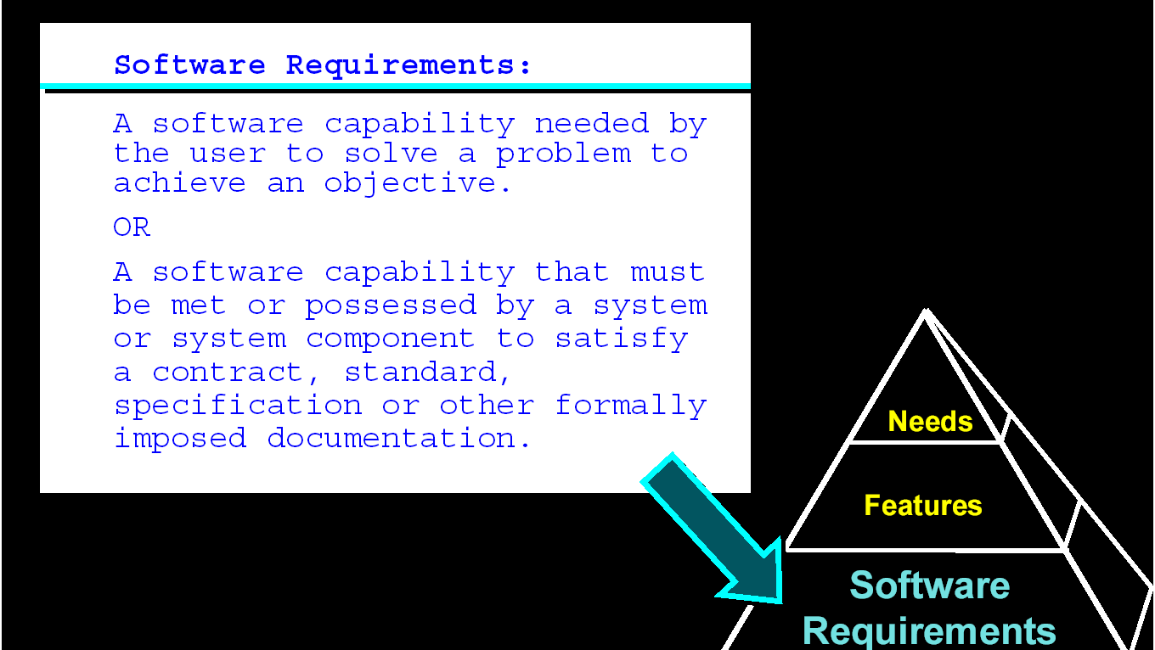
Software Requirements

Slide 35
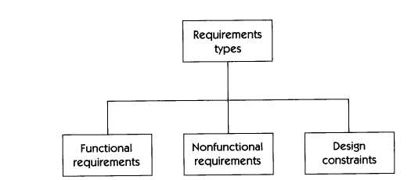
Software Requirements Types

Slide 36

Functional Requirements
Describe the functionality or services that the system is expected to provide
Address the input-output behavior of a system

Slide 37

Examples of Functional Requirements
3.1.1{FR1}
  Software shall automatically detect the presence of the network.
3.1.2{FR2}
  Software shall automatically detect the presence of other computers running the application that are connected to the network.

Slide 38
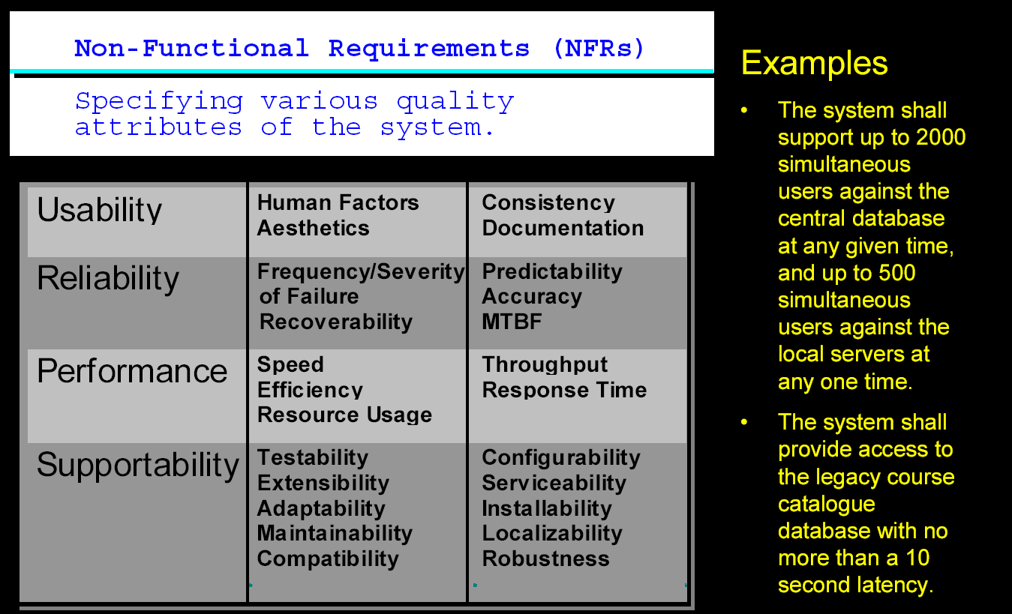
Non-Functional Requirements

Slide 39
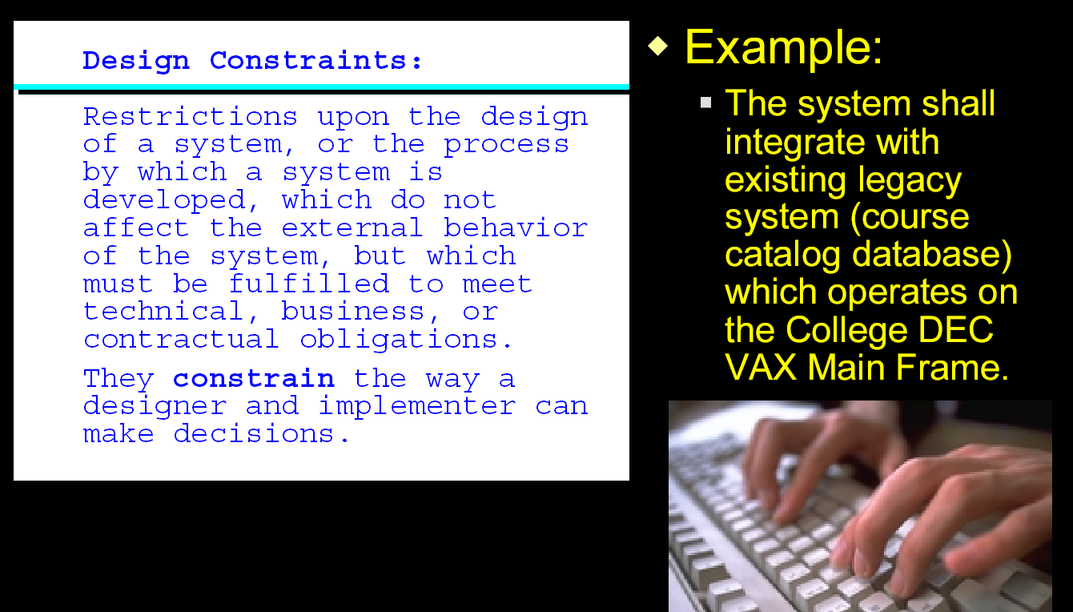
Design Constraints

Slide 40
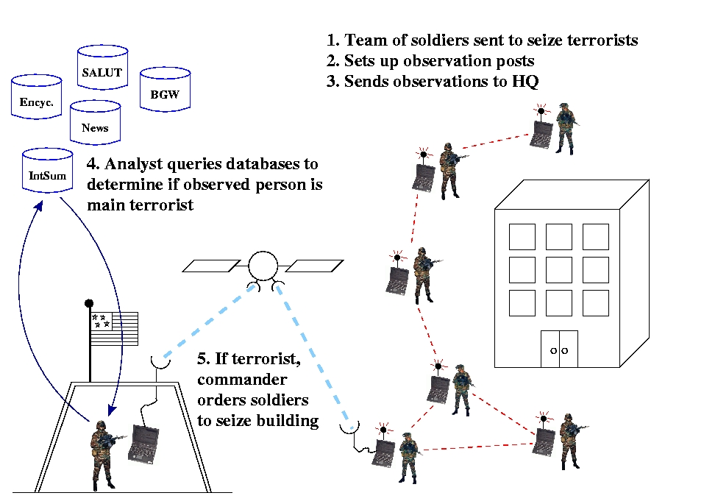
User Scenarios（用户脚本）
How to describe the requirements?
Scenarios ( use-case ):
  identify a thread of usage for the system to be constructed.
  Provide a description of how the system will be used

Slide 41
Example: Dice Game
Use Case Model:
Actor’s goal is to
Dice Game Brief Description:
A player rolls two dice.
If the total is seven, the player wins; otherwise he loses.
Play DiceGame
Actor is the Player

Slide 42
Play DiceGame: Main Scenario
Player indicates to the system that s/he wishes to start a new game. [Trigger]
System indicates that the player can take a turn.
Player indicates that s/he wishes to take a turn.
System simulates rolling a die and displays the face value.
Steps 3 and 4 are repeated once.
System calculated the total and displays congratulations message.
Alternatives?

Slide 43

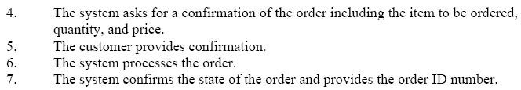
Example: Create an Order Main Scenario

Slide 44

Elicitation Work Products
Statement of need and feasibility.
Statement of scope.
List of participants in requirements elicitation.
Description of the system’s technical environment.
List of requirements and associated domain constraints.
List of usage scenarios.
Any prototypes developed to refine requirements.

Slide 45
Outline
What is RE?
RE Tasks
RE Process
Eliciting Requirements（需求获取）
Developing Use-Case（用例）
Building the Analysis Model
Negotiating Requirements
Validating Requirements

Slide 46
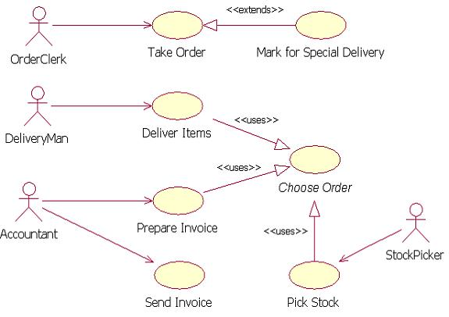
Developing Use-Cases
A use-case is a story about how someone or something external to the software (known as an actor) interacts with the system.
Use-case are defined from an actor’s point of view.
An actor is a role that people or devices play as they interact with the software.

Slide 47

Developing Use-Cases
Each scenario answers the following questions:
  Who is the primary actor, the secondary actor(s)?
  What are the actor’s goals?
  What preconditions should exist before the story begins?
  What main tasks or functions are performed by the actor?
  What exceptions might be considered as the story is described?
  What variations in the actor’s interaction are possible?
  What system information will the actor acquire, produce, or change?
  Will the actor have to inform the system about changes in the external environment?
  What information does the actor desire from the system?
  Does the actor wish to be informed about unexpected changes?

Slide 48
Outline
What is RE?
RE Tasks
RE Process
Eliciting Requirements（需求获取）
Developing Use-Case（用例）
Building the Analysis Model
Negotiating Requirements
Validating Requirements

Slide 49

Building the Analysis Model
Elements of the Analysis Model;
Analysis Patterns;

Slide 50
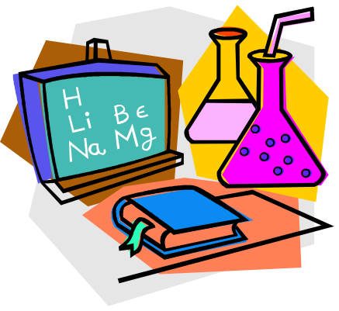
Elements of the Analysis Model
Scenario-based elements
  Use-case—How external actors interact with the system (use-case diagrams; detailed templates)
  Functional—How software functions are processed in the system (flow charts; activity diagrams)
Class-based elements
  The various system objects (obtained from scenarios) including their attributes and functions (class diagram)
Behavioral elements
  How the system behaves in response to different events (state diagram)
Flow-oriented elements
  How information is transformed as if flows through the system (data flow diagram)

Slide 51
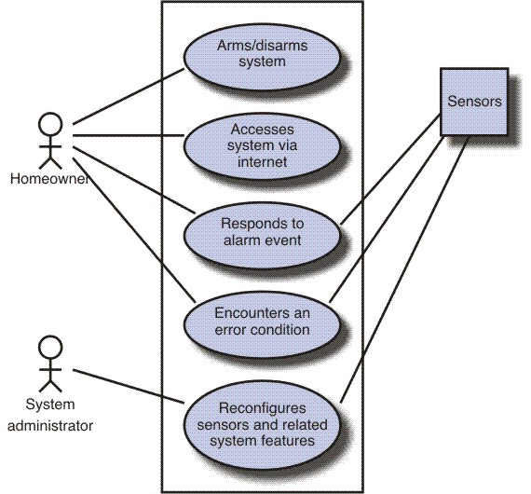
Use-Case Diagram

Slide 52
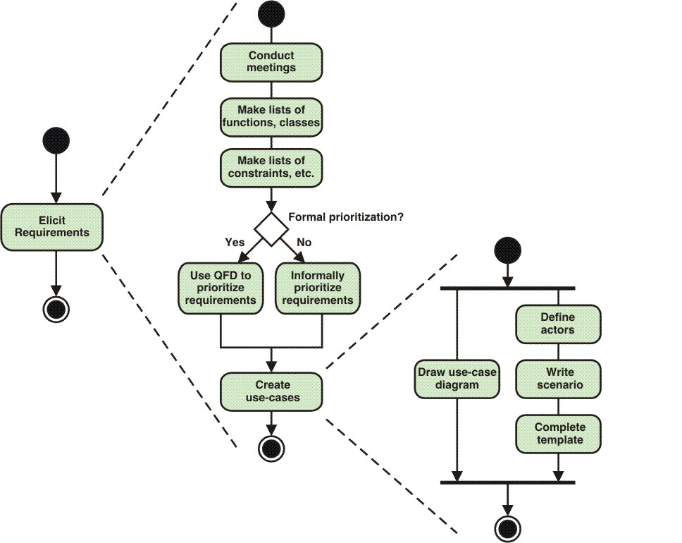
Activity Diagram for RE

Slide 53
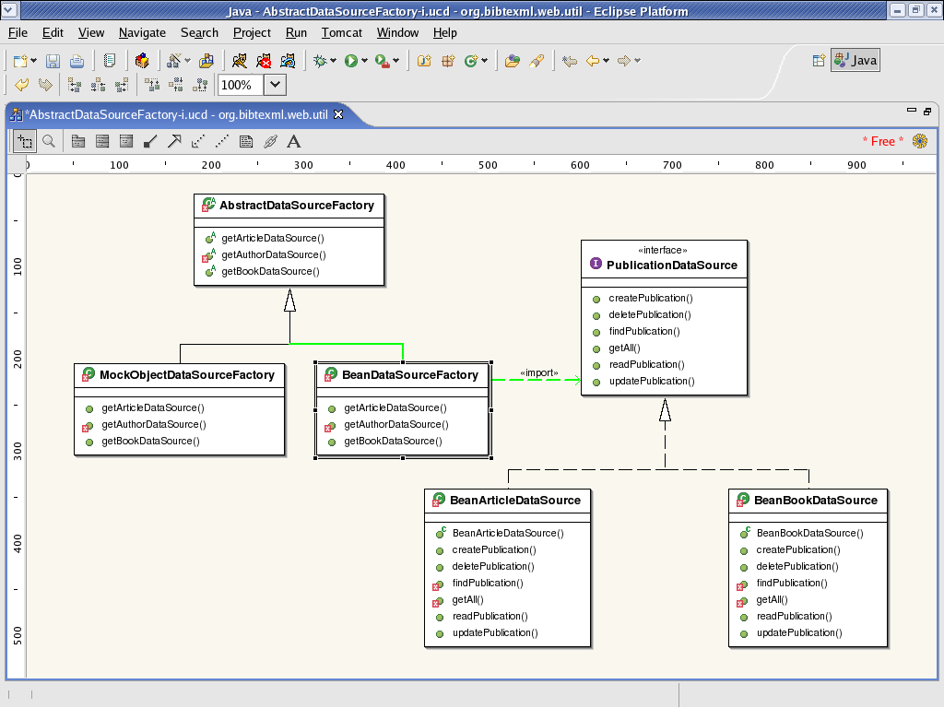
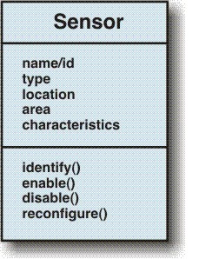
Class Diagram

Slide 54
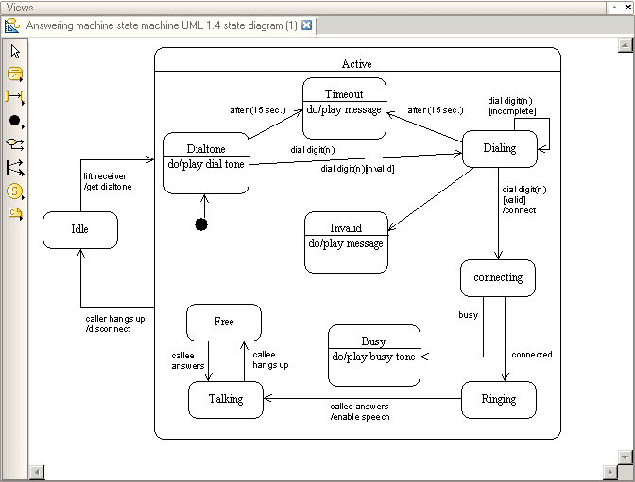
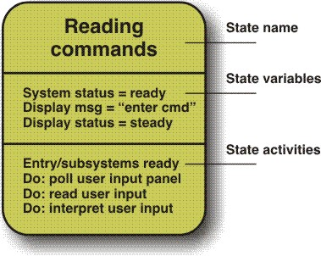
State Diagram

Slide 55


Analysis Patterns
  They are conceptual models, which capture an abstraction of a situation that can often be encountered in modeling.
  Analysis patterns suggest solutions within the application domain that can be reused when modeling many application.
    Analysis patterns speed up the development of abstract analysis models.
    Analysis patterns facilitate the transformation of the analysis model into a design model.

Slide 56
Analysis Patterns
  Pattern name: Captures the essence of the pattern.
  Intent: What the pattern accomplishes or represents.
  Motivation: A scenario that illustrates how the pattern solves a problem.
  Forces and context: External issues (forces) that affect how the pattern is used, and external issues resolved when the pattern is applied.
  Solution: How the pattern is applied to solve the problem; emphasizes structural and behavioral issues.

Slide 57
Analysis Patterns
  Consequences: What happens when the pattern is applied; what trade-offs exist during its application.
  Design: How the pattern can be achieved via known design patterns.
  Known uses: Examples of uses within actual systems.
  Related patterns: Patterns related to the named pattern because
    they are commonly used with the named pattern;
    they are structurally similar to the named pattern;
    they are a variation of the named pattern.

Slide 58
Outline
What is RE?
RE Tasks
RE Process
Eliciting Requirements（需求获取）
Developing Use-Case（用例）
Building the Analysis Model
Negotiating Requirements
Validating Requirements

Slide 59

Negotiating Requirements
Identify the key stakeholders
  These are the people who will be involved in the negotiation
Determine each of the stakeholders “win conditions”
  Win conditions are not always obvious
Negotiate
  Work toward a set of requirements that lead to “win-win”

Slide 60
Outline
What is RE?
RE Tasks
RE Process
Eliciting Requirements（需求获取）
Developing Use-Case（用例）
Building the Analysis Model
Negotiating Requirements
Validating Requirements

Slide 61

Validating Requirements
Is each requirement consistent with the objective of the system?
Have all requirements been specified at the proper level of abstraction?
Is the requirement really necessary?
Is each requirement bounded and unambiguous?
Does each requirement have attribution?
Do any requirements conflict with other requirements?
Is each requirement achievable in the system’s technical environment?
Is each requirement testable, once implemented?
Does the model reflect the system’s information, function and behavior?
Has the model been appropriately “partitioned”?
Have appropriate requirements patterns been used?

Slide 62

Summary
What is RE?
RE Tasks
RE Process
Eliciting Requirements（需求获取）
Developing Use-Case（用例）
Building the Analysis Model
Negotiating Requirements
Validating Requirements

